Slide 1
CAPSTONE PROJECT ON WESTERN COUNTRIES FINANCIAL DATA PRESENTED BY ROHAN ARORA
Notes:
CAPSTONE PROJECT ON
WESTERN COUNTRIES FINANCIAL DATA
PRESENTED BY ROHAN ARORA

Slide 2
CONTENT
Introduction.
Data Exploration and Summarization.
Data Cleaning and Statistical Analysis in Excel.
Graphical Analysis and Insights using Excel.
Database Setup and SQL Operations.
Running Query in SQL.
Data Import To Power BI From SQL Database.
Data Preparation and Visualization in Power BI.
Interactive Dashboard Creation in Power BI.
Conclusion

Slide 3
INTRODUCTION
This capstone project explores financial and operational data from various western countries, spanning multiple business segments such as Government, Enterprise, Small Business, Midmarket, and Channel Partners. The dataset encompasses key metrics like sales, units sold, discounts, cost of goods sold (COGS), and profit across products including Carretera, Amarilla, Montana, Paseo, Velo, and VTT. The time series ranges from September 2013 to December 2014, providing rich insights into trends across geography, product categories, and seasonal variations.
To analyze and derive actionable insights from the dataset, the following tools were used:
🧹 Excel and Statistics Used for initial data cleaning, preprocessing, and statistical computations such as mean, median, variance, and standard deviation. Excel also facilitated the creation of pivot tables, slicers, and cards for quick summarization and visualization.
🧠 SQL Employed to structure and query data efficiently, enabling deeper exploration and extraction of business-critical metrics, such as top-performing countries and segments.
📈 Power BI Utilized to build interactive dashboards and dynamic visualizations that highlight trends, comparisons, and performance indicators with clarity and precision.

Slide 4
DATA EXPLORATION AND SUMMARIZATION
Data Summary
Total Variables: 16
Total Observations: 700
• Missing Values:
• Discounts: 53 Missing Values
• Profit: 5 Missing Values
• Duplicate Rows: 0 (No Duplicates)
• Column Types:
• Categorical Columns: Segment, Country, Product, Discount Band, Month Name
• Numerical Columns: 10
• Date-Time Column: 1
Variable Overview
Categorical Variables:
Segment (5 unique values),Country (5), Product (6),Discount Band (4).
Numerical Variables:
Units Sold(510), Manufacturing Price(6),Sale Price (7), Gross Sales(550).
Discounts (515) → 53 missing values.
Sales (559), COGS(545),Profit (557) → 5missing values in Profit.
Date-Time Variables:
Date (16 unique values), Month Number (12),Month Name (12),Year (2).

Slide 5
DATA CLEANING STEPS
Cell Expansion Using Column Separator Expanded cells displaying the # symbol by adjusting column width using the column separator to reveal the full content.
Data Alignment Center-aligned all columns to ensure uniform presentation and improve readability.
3.Handling Missing Values and Symbols
Identified and addressed blank or missing cells.
Replaced currency symbols such as $ by setting the format to “None” under the Format Cells option.
Converted entries showing – into 0 where appropriate, ensuring consistent numeric representation.
4.Duplicate Detection Checked for duplicate entries across all columns. Since duplicates may not be valid in all fields, ensured uniqueness where necessary.
5.Decimal Precision Reduced the number of decimal places using the Home tab → Number settings or through the Format Cells dialog to maintain consistent precision.
6.Comma Removal in Numeric Fields Removed commas from numerical values to prevent Excel from interpreting them as text. This was achieved using the Format Cells option with a custom format.
7.Chronological Sorting Organized the dataset chronologically by sorting the date column in ascending (oldest to newest) or descending order, enabling better temporal analysis.

Slide 6
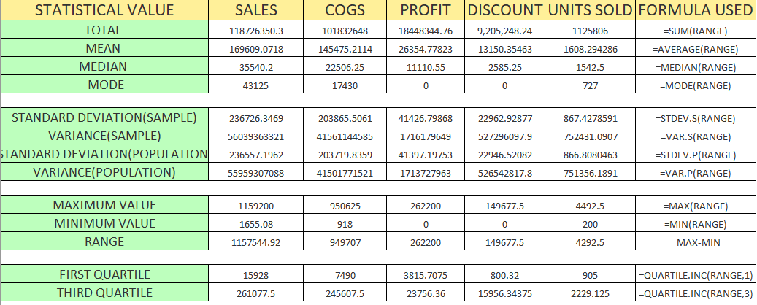
STATISTICAL ANALYSIS IN EXCEL

Slide 7
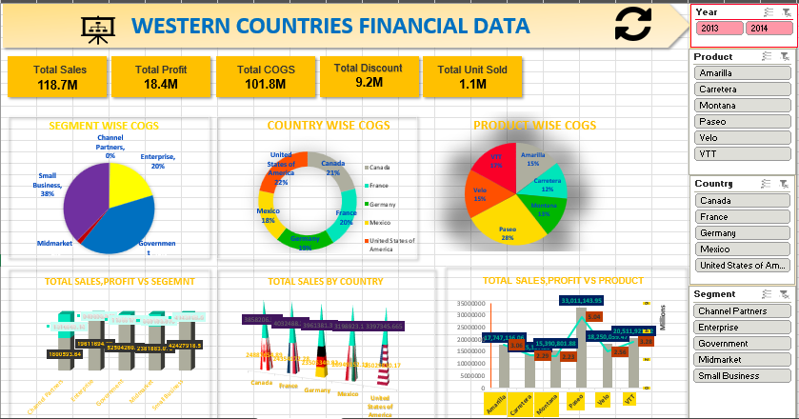
GRAPHICAL ANALYSIS USING EXCEL

Slide 8
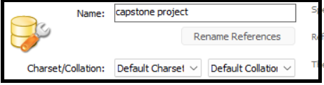
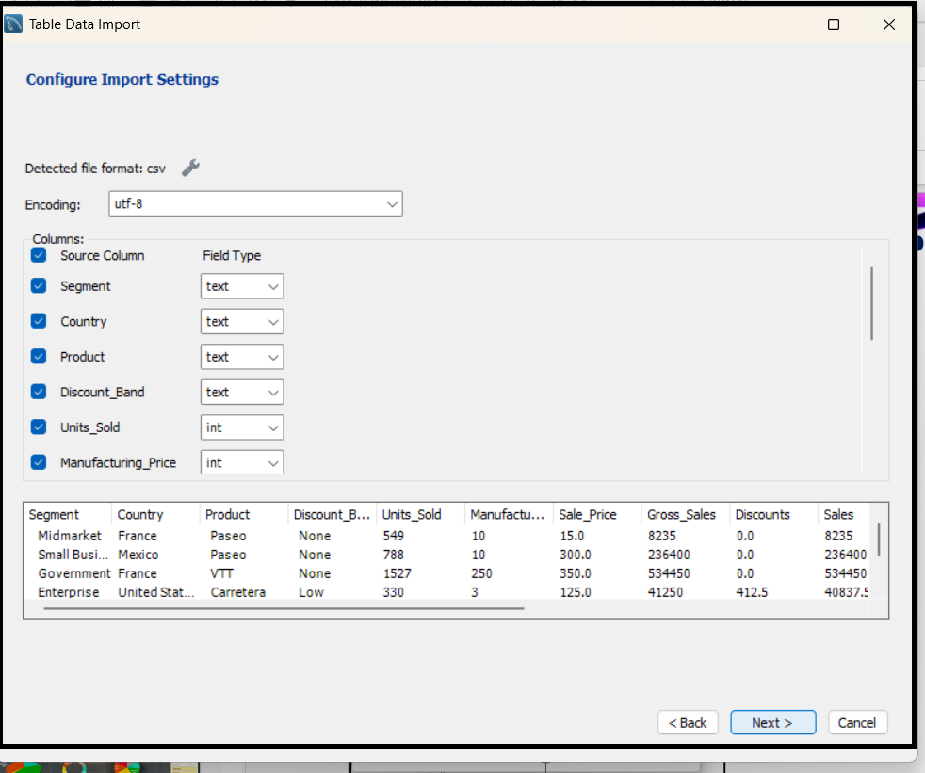
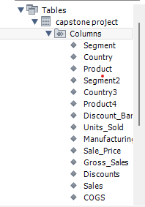
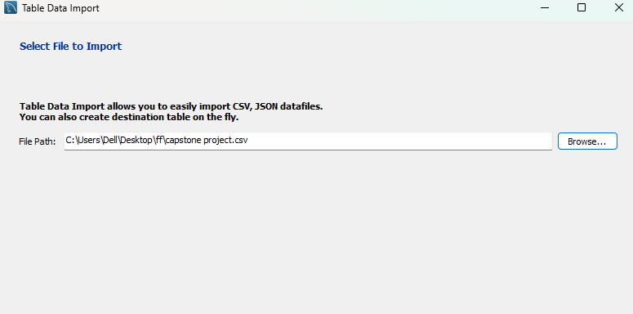
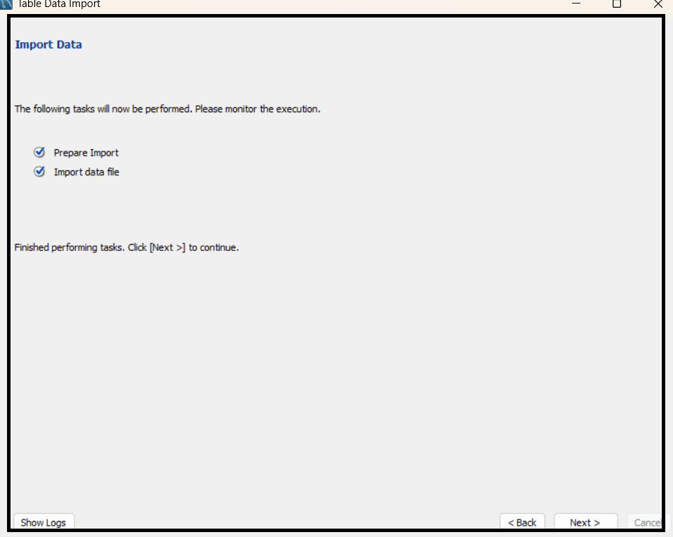
DATABASE SETUP AND SQL OPERATORS
CREATING SCHEMA
3. DATATYPE EDITION
4. SHOWING DATABASE
2. IMPORTING DATASET

Slide 9
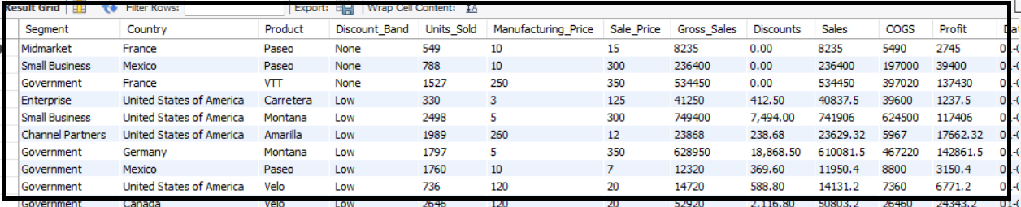

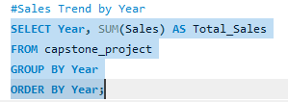

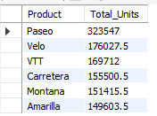
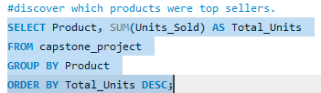
SQL QUERIES

Slide 10
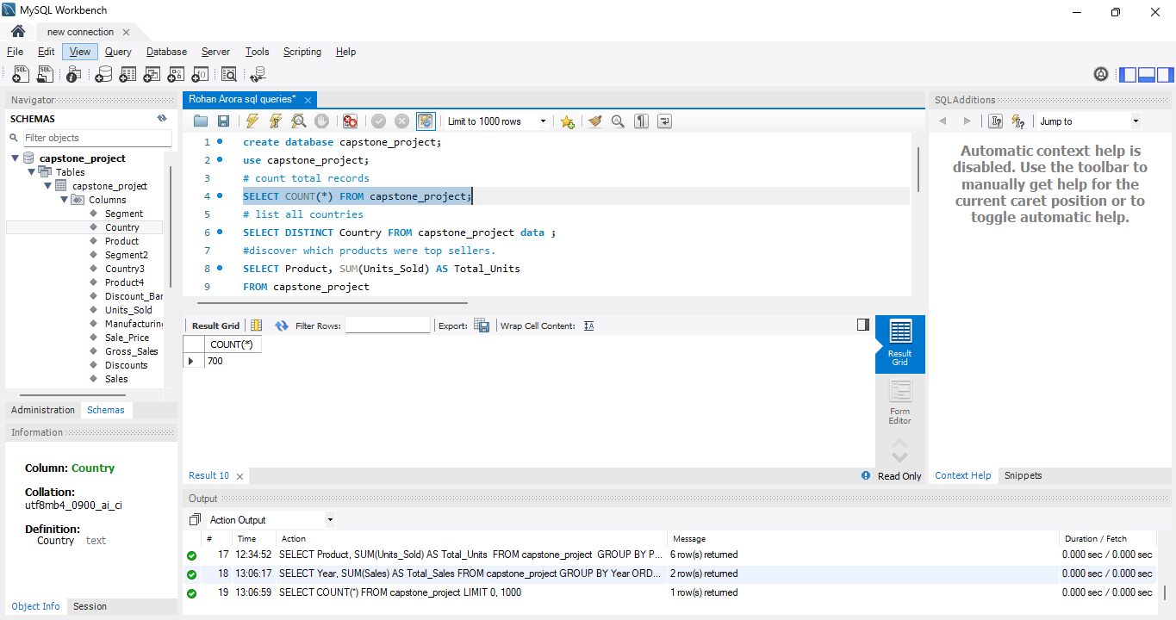
Overall Creation of DB & Queries

Slide 11
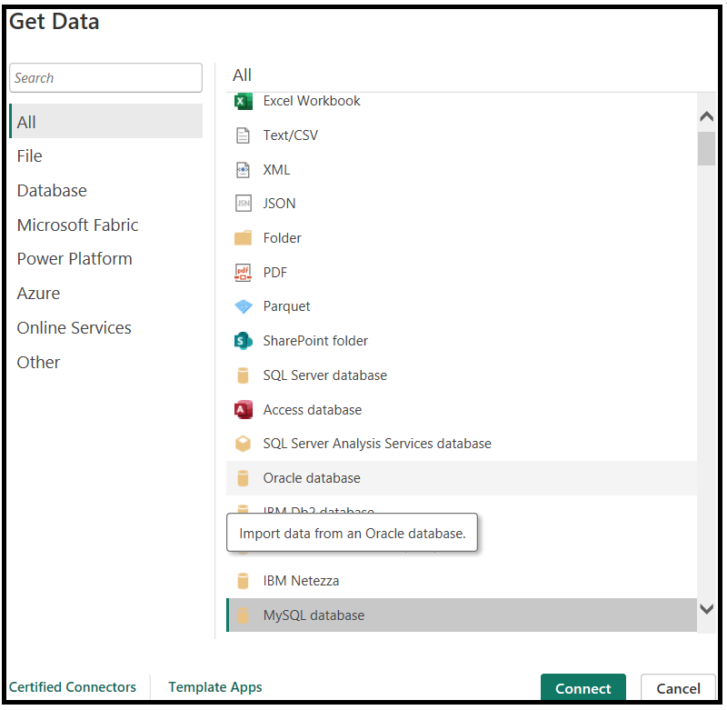
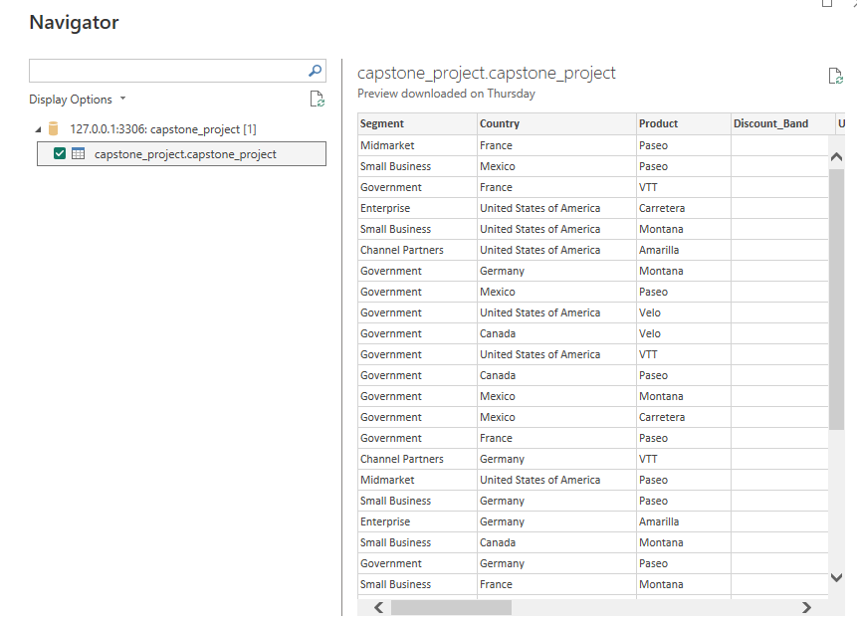
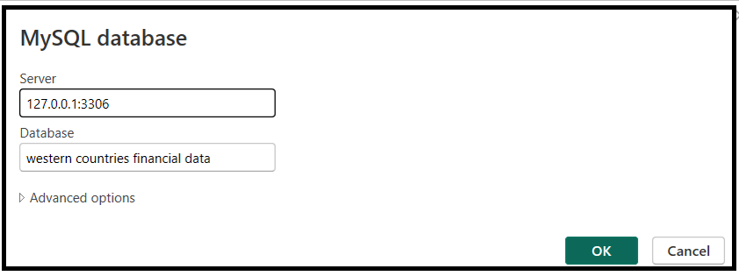
Data IMPORT FROM SQL DATABASE TO POWERBI
Opened Power BI and navigate to Home Tab. Clicked on Get Data → Select MySQL Database from the list.
Enter the Server Address:127.0.0.1:3306.
Enter the Database Name: capstone_project
Click OK
Click Load to import the data into Power BI for analysis

Slide 12
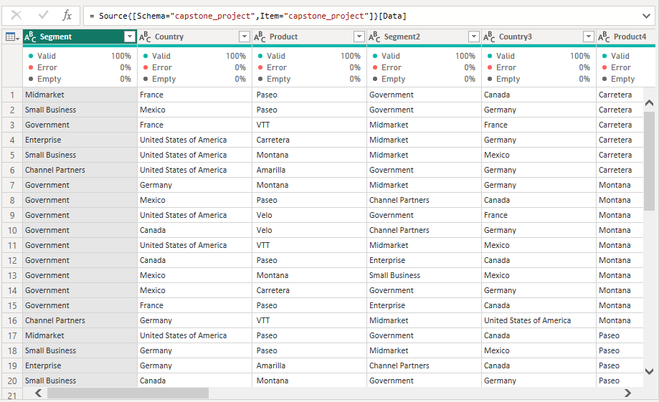
Using power query editor for cleaning and Modifying error

Slide 13
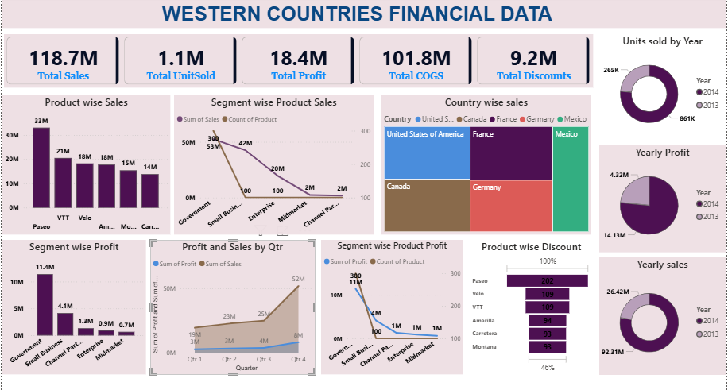
Power Bi dashboard

Slide 14
conclusion
🌍 Top Countries by Performance
United States:
Sales: ₹25,029,830
Profit: ₹3,397,346
Canada:
Sales: ₹24,887,655
Profit: ₹3,858,206
📉 Bottom Products by Sales
Carretera:
Sales: ₹13,815,308
Profit: ₹2,289,025
Montana:
Sales: ₹15,390,802
Profit: ₹2,227,807
Velo:
Sales: ₹18,250,059
Profit: ₹2,556,905
Government segment drives 44% of total sales—suggests priority focus.
Paseo accounts for over 25% of overall revenue—
key product for expansion.
Discounts are concentrated in high-volume products—revisit pricing strategy.

Slide 15
THANK YOU

